Slide 1
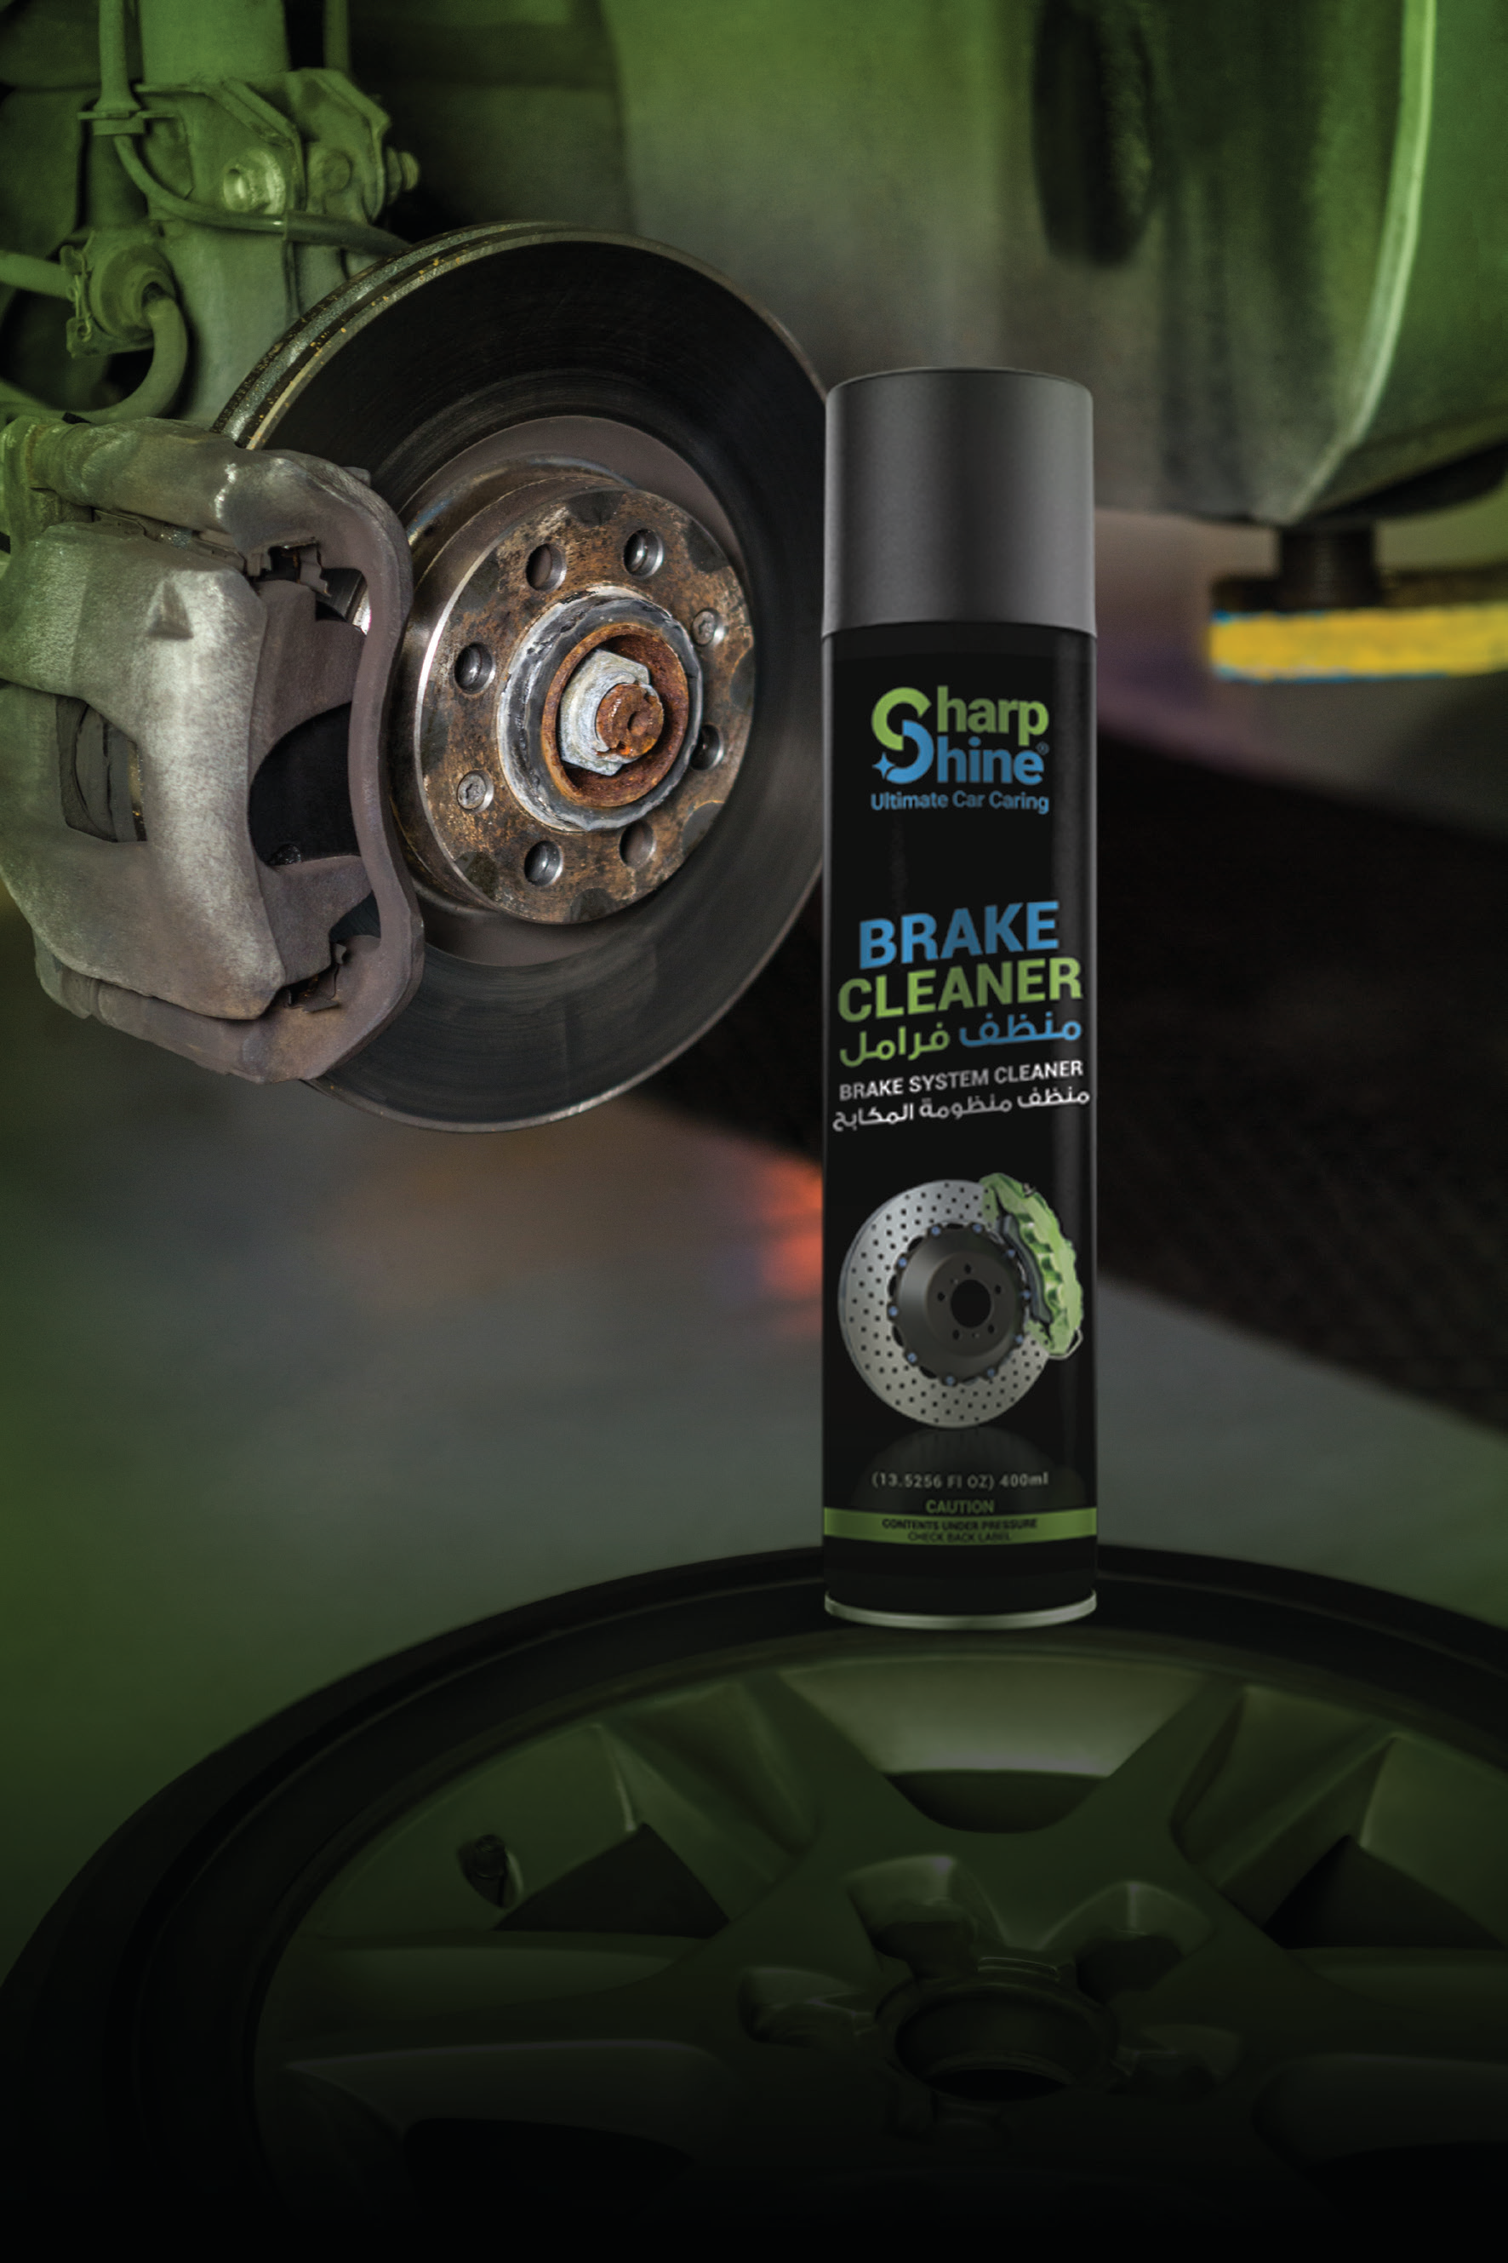

COMPANY PROFILE
We Don't Relabel. We Manufacture.
Car Care & Industrial Chemicals • Formulated and Filled in Egypt

Slide 2
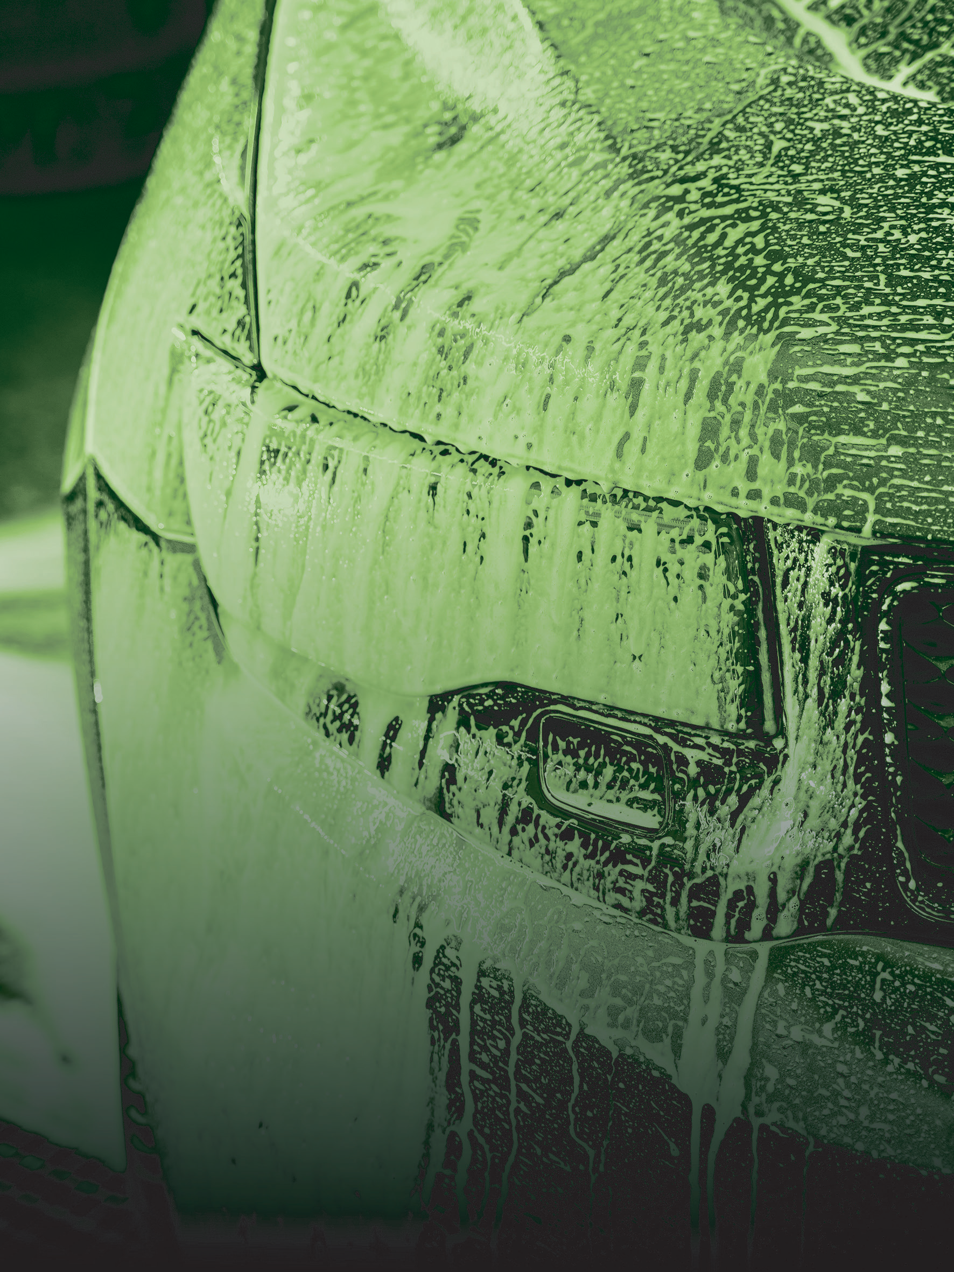
WE DON'T RELABEL.
WE MANUFACTURE.
SharpShine® formulates and fills its own car care and industrial chemicals at its own plant on the Cairo–Alexandria desert road — from 120ML retail units to 20L workshop drums, certified and ready for export.
02

Slide 3
WHO WE ARE
A Manufacturer, Not a Label.
SharpShine® is formulated, filled and quality-tested by Ocean Goods® — its sister manufacturing company, founded by the same engineer — at the Abu Rawash plant on the Cairo–Alexandria desert road in Giza, Egypt. Because SharpShine® and Ocean Goods® share ownership, a plant and a quality system, questions on formulation, packing and batch consistency are answered directly, without passing through a third party.
The brand began as a small-scale idea in Egypt, not as a trading company: why should a detailer settle for imported formulas never designed for local conditions? That question led to the decision to manufacture rather than outsource — and today the range has grown to four solution categories produced by one formulation team under one quality system.
What began locally has grown into a brand serving professional detailers, distributors and retail customers across the Middle East, with distribution territories now opening in Europe and the Gulf.
“Every formula tells our story: precision-engineered, tested by experts, and trusted by professionals.”
— Eng. Mohamed Tohamy, Founder, SharpShine® & Ocean Goods®
03

Slide 4
OUR STORY
How SharpShine® Started.
01
02
03
04
05
The Idea
Making It Ourselves
Four Ranges
Beyond Egypt
Where We Are Now
A vision of Eng. Mohamed Tohamy: redefine automotive care through science, not packaging.
The decision to manufacture rather than outsource — formulation, filling and release testing under one roof.
Car care first, then maintenance & performance, then performance enhancement, then industrial — one chemistry team.
Growth into a regional brand serving detailers, distributors and retail customers across the Middle East.
ISO, EOS and SABER certified, and opening distribution territories in Europe and the Gulf.
Four ranges, one formulation team, one quality system.
04

Slide 5
DIRECTION
Vision & Mission
OUR VISION
OUR MISSION
To be a car care brand professionals trust anywhere it is sold — known for excellence, responsibility, and a relentless drive to make every car owner proud of their shine.
To redefine auto care standards through innovative, sustainable and high-performance products that protect, enhance and celebrate every vehicle.
05

Slide 6
WHAT GUIDES US
Core Values
EXCELLENCE
INNOVATION
SUSTAINABILITY
CUSTOMER FOCUS
We obsess over every detail to deliver unmatched results.
We push the boundaries of what car care can achieve.
We craft eco-conscious products that protect your car and the planet.
Your satisfaction drives everything we do.
06

Slide 7
BY THE NUMBERS
The Scale Behind the Label.
23+
3,500+
100+
10+
Premium Products
Satisfied Clients
Experienced Professionals
Years in the Field
Formulated and filled in house
Retail and trade combined
Production, QC and technical
Manufacturing experience
43+
10+
6K+
16+
SKUs
Global Markets
Annual Production Tons
Certifications
Products across all pack sizes
Gulf, Africa and Europe
From our own facility
ISO, EOS and SABER
07

Slide 8
THE SHARP SHINE ADVANTAGE
Why Sharp Shine?
Performance-Driven Formulations
Four Solution Categories
Professional & Consumer Applications
Products engineered around specific automotive cleaning, protection and maintenance requirements — not generic, one-size-fits-all chemistry.
Car care & detailing, maintenance & performance, performance enhancement and industrial solutions — one chemistry team, one quality system.
Products and packaging suited to everyday motorists as well as workshops, detailing centers and professional users.
Retail Shelf to Workshop Drum
Own Plant, Not a Trading House
Quality & Compliance
Every product is filled across the pack sizes the market actually buys — from 120ML consumer units to 20L bulk containers.
Formulation, filling and release testing all happen at one facility — the specification approved is the specification controlled.
ISO 9001, ISO 14001, EOS and SABER certified — supporting distributor confidence and export-market readiness.
08

Slide 9
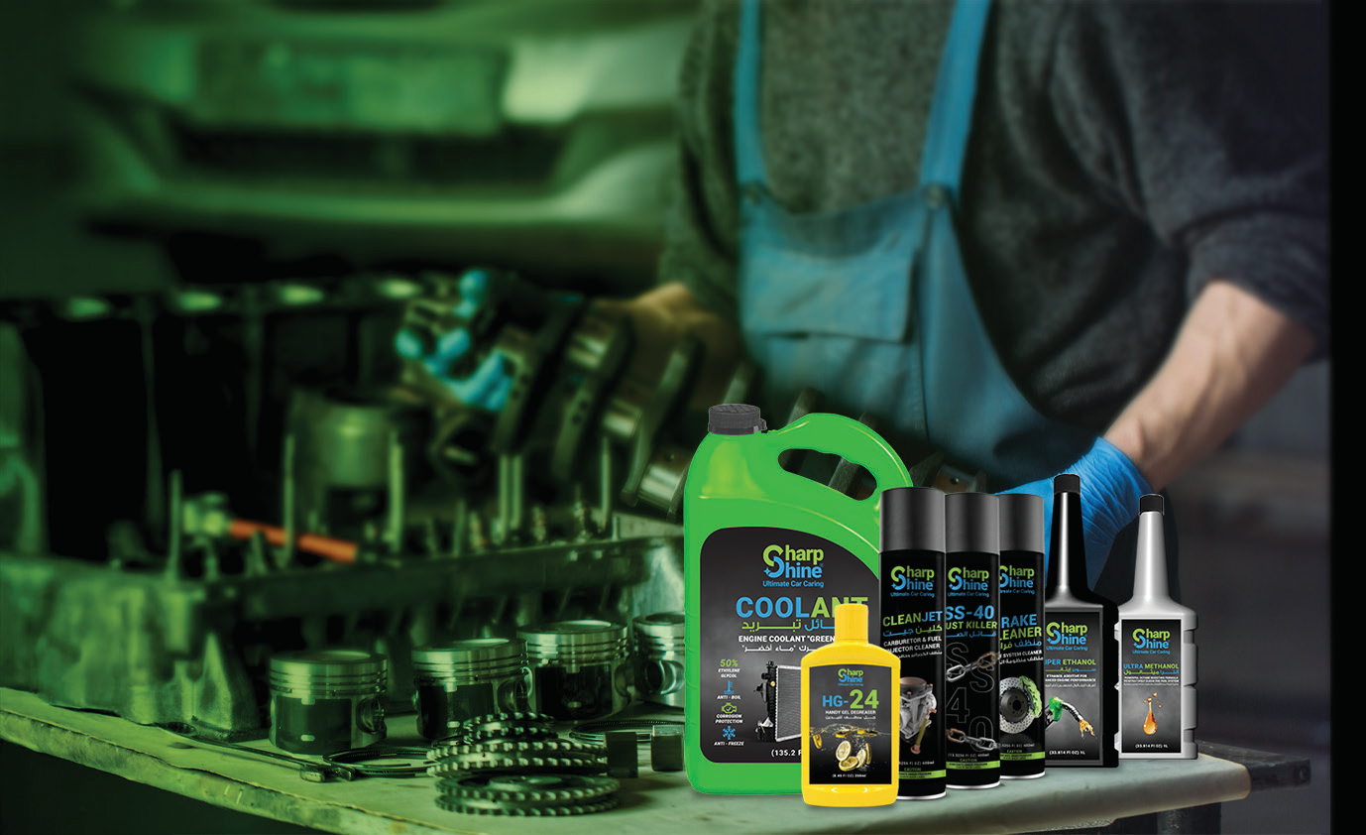
MANUFACTURING
One Plant. One Quality System.
SharpShine® products are manufactured by Ocean Goods® — its sister company — at Km 26, Abu Rawash industrial zone on the Cairo–Alexandria desert road, Giza. Formulation, filling and release testing happen on one site, with the same batch discipline applied to a retail bottle and a workshop drum.
Product Concept
Formula Development
Raw Material Selection
Production
Quality Control
Filling & Packaging
Finished Product
Market
09

Slide 10
QUALITY PROCESS
Quality at Every Stage.
1
2
3
4
5
6
7
8
→
→
→
→
→
→
→
Raw Material
Selection
Formulation
Production
Quality
Control
Filling
Packaging
Storage
Distribution
One company controls the formula, the fill and the release test on a single site.
10

Slide 11
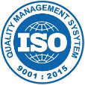


CERTIFICATIONS
Certifications & Quality Standards
SharpShine® operates under ISO 9001 and ISO 14001 management systems, carries EOS certification on Egyptian market products, and holds SABER registration for entry into the Saudi market.
EOS
ISO 9001:2015
ISO 14001:2015
EOS Certified
SABER / Saudi Conformity
Quality Management System covering manufacturing and quality control.
Environmental Management System for the production site.
Egyptian Organization for Standardization — certified on Car Shampoo and Heavy-Duty Degreaser.
10+ compliance certificates for entry into the Saudi market (SASO requirements).
Ethanol (99.42% purity) and Methanol (99.01% purity) are additionally EOS-tested by gas chromatography. Certificate files are issued to distributors on request.
11

Slide 12
PORTFOLIO ARCHITECTURE
Four Ranges, One Chemistry Team.
01
CAR CARE & DETAILING
02
MAINTENANCE & PERFORMANCE
Shampoo with carnauba wax, polisher wax, dashboard, tyre and glass products.
Degreasers, brake cleaner, rust treatment, wheel cleaner, handy gel.
03
PERFORMANCE ENHANCEMENT
04
INDUSTRIAL SOLUTIONS
Coolant (red & green), super ethanol, ultra methanol.
The same degreasing and rust chemistry, packed for workshops and plants.
12

Slide 13
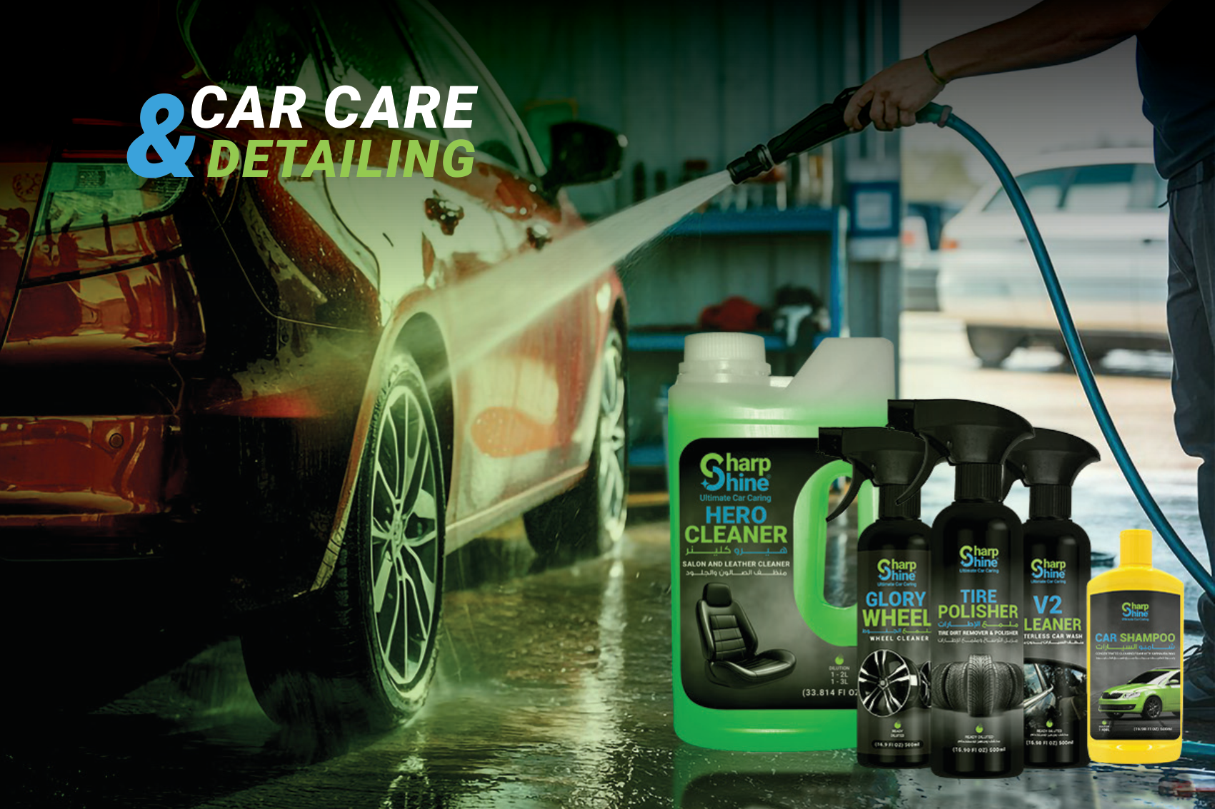
13

Slide 14
PORTFOLIO · CATEGORY 01
Car Care & Detailing Range
Product | Primary Function | Key Benefit | Sizes
Car Shampoo with Carnauba Wax | Concentrated cleaning foam | Deep cleaning with a Carnauba Wax protective finish | 500ML · 5L · 20L
Tire Dirt Remover & Polisher | Tire cleaner & polisher | Restores tires and shields against UV, dirt & moisture | 500ML · 1L · 5L · 20L
Super Shine Dashboard Polisher | Dashboard polisher | Radiant, long-lasting interior shine with natural oils | 250ML · 1L · 5L · 20L
Hero Cleaner | Salon & leather cleaner | Deep cleaning with fabric-preserving protection | 400ML – 20L
Wind Shield Washer | Windshield washer & cleaner | Streak-free visibility, prevents fogging | 120ML – 20L
V2 Cleaner | Waterless car wash | Quick, water-free touch-ups with a high-lubricity formula | 500ML
Ultimate Polisher Wax | Carnauba car wax | Double-layer wax protection with a lasting glossy finish | 250ML
Glory Wheel | Wheel cleaner | Removes brake dust & grime, brightens metal and chrome | 500ML
14

Slide 15
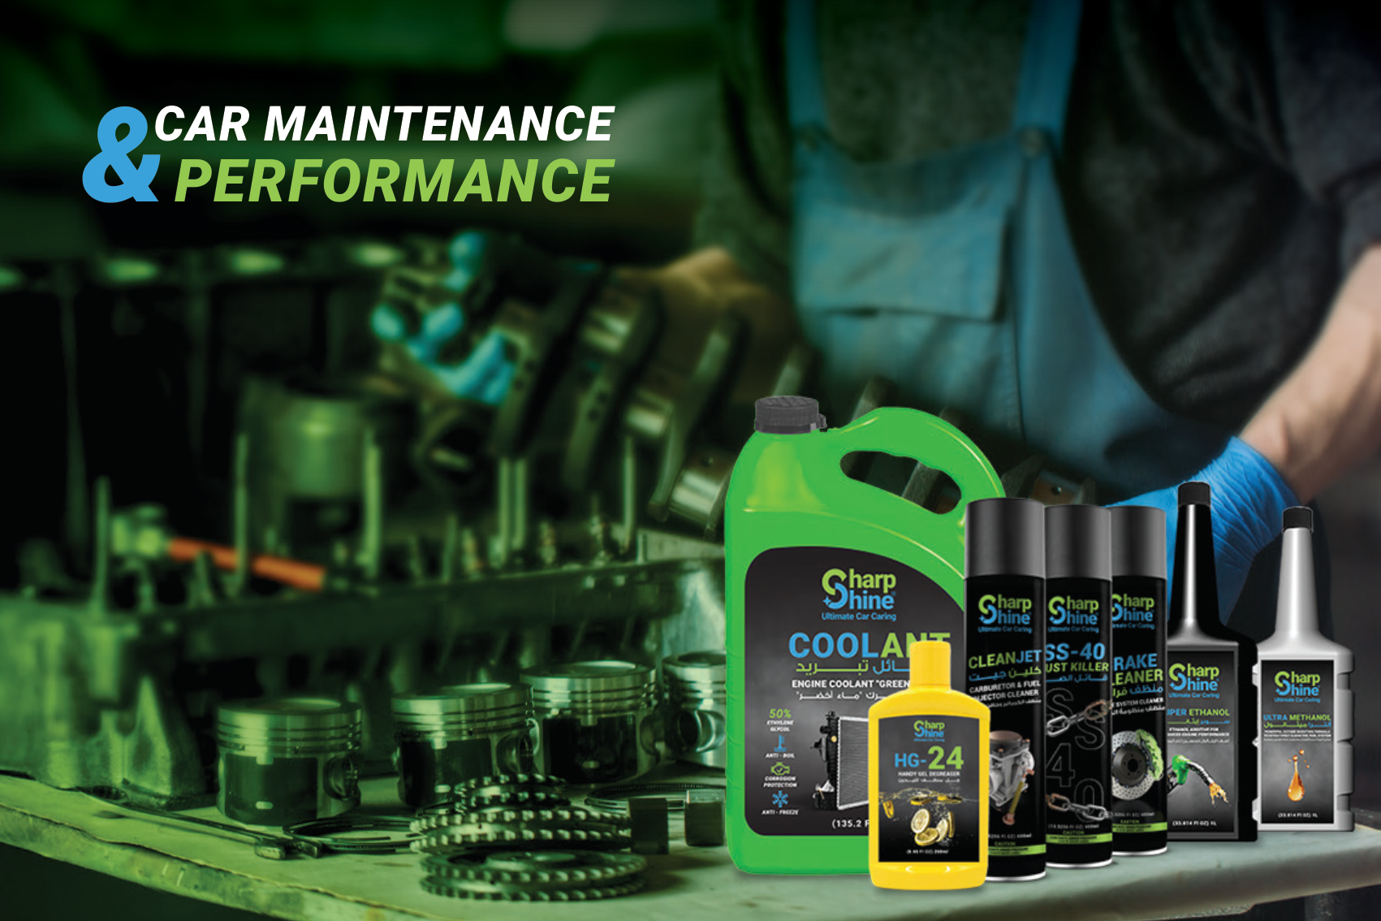
15

Slide 16
PORTFOLIO · CATEGORY 02
Maintenance & Performance Range
Product | Primary Function | Key Benefit | Sizes
Multipurpose Degreaser | Heavy & engine degreaser | Removes grease/grime, protects against oxidation | 400ML – 20L
HG-24 Handy Gel Degreaser | Hand degreaser | Gentle on skin, removes oils, fats & dirt | 250ML
SS-40 Rust Killer | Multi-purpose aerosol | Cleans, lubricates, un-jams and protects metal parts | 400ML
Brake Cleaner | Brake system cleaner | Removes grease/dust, reduces brake squeal, fast-drying | 400ML
CleanJet | Carburetor & fuel injector cleaner | Restores power, reduces emissions, protects injectors | 400ML
In development (R&D): Multipurpose Degreaser Foam · Hero Cleaner Foam — contact us for availability.
16

Slide 17
PORTFOLIO · CATEGORY 03
Performance Enhancement Range
Fuel and cooling-system fluids designed to protect the engine and improve combustion efficiency.
Product | Primary Function | Key Benefit | Sizes
Sharp Shine Coolant (Red) | Engine coolant | Regulates temperature, prevents rust & corrosion | 1L · 4L
Sharp Shine Coolant (Green) | Engine coolant | Regulates temperature, prevents rust & corrosion | 1L · 4L
Super Ethanol | Ethanol fuel additive | Increases octane rate, cleaner combustion | 1L · 5L
Ultra Methanol | Octane-boosting fuel formula | Cleaner combustion, smoother engine operation | 1L · 5L
In development (R&D): Octane Booster · Radiator Cleaner · Injection Cleaner · Fuel System Cleaner · Catalytic Cleaner — contact us for availability.
17

Slide 18
PORTFOLIO · CATEGORY 04
Industrial Solutions Range
The same degreasing and rust-treatment chemistry from the Maintenance & Performance range, packed for workshops and industrial plants.
Product | Primary Function | Key Benefit | Sizes
SS-40 Rust Killer | Multi-purpose aerosol | Cleans, lubricates, un-jams and protects metal parts | 400ML
Multipurpose Degreaser | Heavy & engine degreaser | Removes grease/grime, protects against oxidation | 400ML – 20L
HG-24 Handy Gel Degreaser | Hand degreaser | Gentle on skin, removes oils, fats & dirt | 250ML
In development (R&D): Multipurpose Degreaser Pro — contact us for availability.
18

Slide 19
ONE BRAND. COMPLETE COVERAGE.
Complete Vehicle Care
BODY
TIRES
Car Shampoo · Polisher Wax · V2 Cleaner
Tire Dirt Remover & Polisher
WHEELS
INTERIOR
Glory Wheel
Hero Cleaner · Super Shine
WINDSHIELD
ENGINE / MECHANICAL
Wind Shield Washer
Multipurpose Degreaser · SS-40 · CleanJet · Brake Cleaner
COOLING SYSTEM
FUEL PERFORMANCE
Sharp Shine Coolant (Red / Green)
Super Ethanol · Ultra Methanol
19

Slide 20
WHO WE SERVE
Professional Applications
Car Owners
Detailing Centers
Car Washes
Professional-quality care for everyday automotive maintenance.
Specialized products for cleaning, polishing and finishing.
High-use professional solutions and larger pack formats.
Workshops & Service Centers
Dealerships & Showrooms
Fleet Operators
Maintenance, cleaning and mechanical-care solutions.
Vehicle preparation and presentation.
Solutions supporting recurring vehicle-care requirements.
Automotive Retailers
A broad portfolio suited to aftermarket merchandising.
20

Slide 21
BUSINESS MODEL
Consumer. Professional. B2B.
CONSUMER
PROFESSIONAL
RETAIL
Individual vehicle owners — served via the Egypt retail store.
Car washes, detailers, technicians and workshops.
Automotive shops and relevant retail channels.
B2B
DISTRIBUTION
EXPORT
Fleets, service networks, dealerships and corporate customers.
Local distributors, plus export partners across the Gulf, Africa and Europe.
10+ global markets today, with new territories opening in Europe and the Gulf.
21

Slide 22
RETAIL SHELF TO WORKSHOP DRUM
Packaging Flexibility
Every product is filled across the pack sizes the market actually buys — from small consumer formats to bulk industrial containers, all produced on the same line under the same quality system.
120ML
250ML
400ML
500ML
1L
4L
5L
20L
120ML – 500ML
1L
4L – 5L
20L
Consumer Retail
Everyday / Light Professional
Professional
Bulk / Industrial
Retail shelf and everyday personal use
Frequent personal or light workshop use
Detailing centers, workshops, car washes
High-use professional and plant operations
Not every product is available in every size — see the portfolio pages for exact formats per product.
22

Slide 23
PARTNERS
Who Already Works With Us.
Distributors, workshops and industrial accounts carrying Sharp Shine® products.
Chloride
FIT & FIX
RD
Joe Auto Parts
Jamret Shehab
ASHRAFCO
SMG Engineering Automotive Co.
23

Slide 24
PARTNERSHIP
Grow with Sharp Shine.
Potential Partnership Channels
• Automotive retailers
• Distributors & wholesalers
• Car-care chains
• Detailing centers
• Car-wash networks
• Workshops & service centers
• Dealerships
• Fleet operators
• Export & private-label partners
Why Partner With a Manufacturer, Not a Trading House
• Own plant — formulation, filling and release testing on one site
• Four solution categories, 43+ SKUs, from a single supplier
• Pack sizes from 120ML retail to 20L bulk containers
• ISO 9001, ISO 14001, EOS and SABER certified
• Direct line to the people who run the production line
• Territories opening across Europe and the Gulf
24

Slide 25
REGIONAL READINESS
Made in Egypt. Sold Across 10+ Markets.
Sharp Shine® operates from an Egyptian manufacturing base with an existing footprint across the Gulf, Africa and Europe, supported by ISO-certified quality systems and SABER conformity registration. Distribution territories are now opening further across Europe and the Gulf.
EGYPT
Head office & manufacturing base — 6th of October City / Abu Rawash, Giza
GULF, AFRICA & EUROPE
10+ global markets served today, with SABER registration supporting Saudi market entry
• Egyptian manufacturing base (Abu Rawash, Giza)
• 10+ global markets today — Gulf, Africa & Europe
• ISO 9001 & ISO 14001 certified management systems
NEW TERRITORIES
• EOS certified on key Egyptian-market products
Opening distribution territories in Europe and the Gulf — pack configuration, documentation and terms provided per territory
• SABER conformity for the Saudi market
• New territories opening in Europe & the Gulf
25

Slide 26
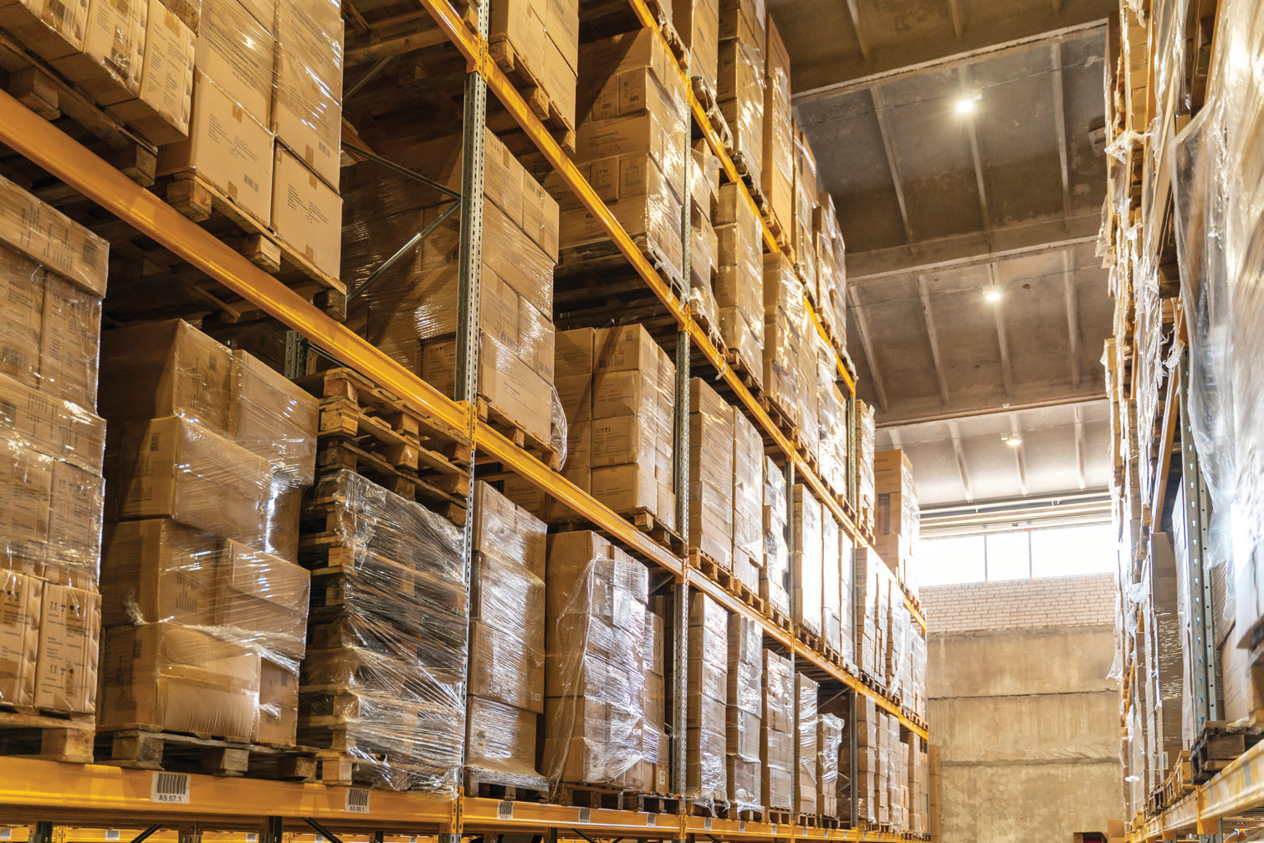
SUSTAINABILITY
Eco-Conscious by Value.
“We craft eco-conscious products that protect your car and the planet” is one of Sharp Shine's four stated core values — backed operationally by ISO 14001:2015 environmental management at the Abu Rawash production site.
Environmental management under ISO 14001:2015
Responsible production practices at the Ocean Goods® facility
Efficient use of raw materials and resources
Continuous environmental performance improvement
Sustainability named as one of four core company values
26

Slide 27
RESEARCH & DEVELOPMENT
The Range Is Still Growing.
SharpShine® grew its range one problem at a time — car care first, then maintenance, then performance enhancement, then industrial. The same approach is behind everything currently in development.
Octane Booster
Radiator Cleaner
Injection Cleaner
Fuel System Cleaner
PERFORMANCE ENHANCEMENT
PERFORMANCE ENHANCEMENT
PERFORMANCE ENHANCEMENT
PERFORMANCE ENHANCEMENT
Catalytic Cleaner
Multipurpose Degreaser Foam
Hero Cleaner Foam
Multipurpose Degreaser Pro
PERFORMANCE ENHANCEMENT
MAINTENANCE & PERFORMANCE
MAINTENANCE & PERFORMANCE
INDUSTRIAL SOLUTIONS
Items marked Under R&D are in development — contact us for availability.
27

Slide 28
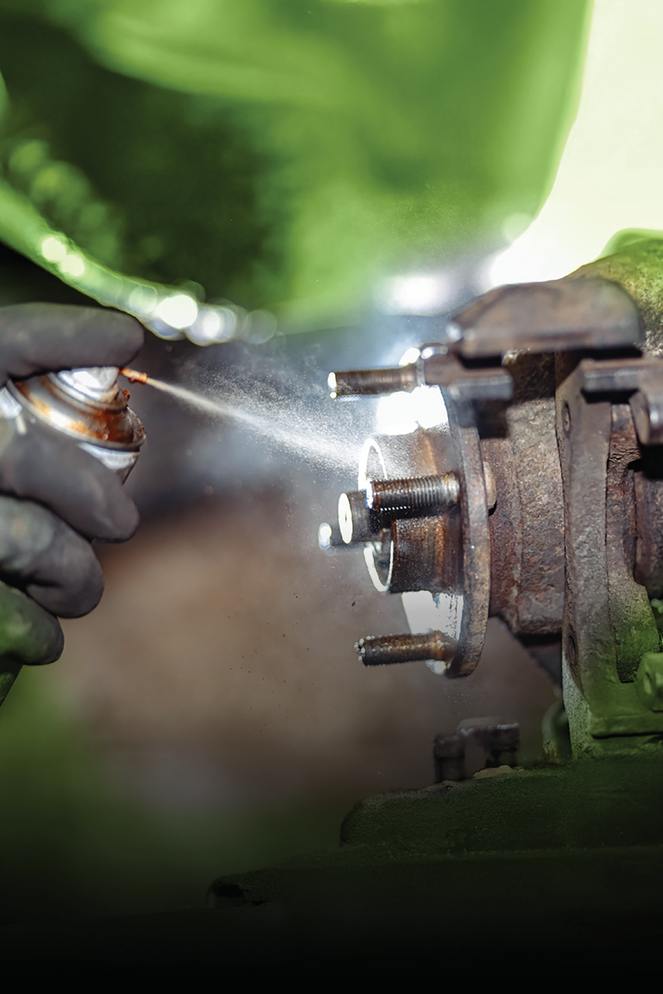
CLEANER. STRONGER. SHARPER.
Professional automotive and industrial solutions — formulated, filled and quality-tested at our own plant in Egypt.
28

Slide 29
DECISION SUMMARY
Why Partner With Sharp Shine?
Own Plant — Not a Trading House
Four Solution Categories, 43+ SKUs
ISO 9001, ISO 14001, EOS & SABER Certified
10+ Global Markets — Gulf, Africa & Europe
120ML to 20L Pack Flexibility
Direct Line to the People Who Make the Product
10+ Years of Manufacturing Experience
New Territories Opening in Europe & the Gulf
MORE THAN PRODUCTS. A MANUFACTURER YOU CAN AUDIT.
29

Slide 30
TALK DIRECTLY TO
THE MANUFACTURER.
SHARP SHINE®
Ultimate Car Caring
Manufactured by Ocean Goods®, our sister company, at our own plant in Giza, Egypt. Own formulation. Own fill. Own quality control.
Distribution enquiries, technical questions and product advice all reach the team that runs the plant — not a reseller.
EMAIL
info@sharp-shine.com
OFFICE
+202 365 80 844
MOBILE / WHATSAPP
+20 101 2222 011
Founder
Eng. Mohamed Tohamy
WEBSITE
www.sharp-shine.com
EGYPT RETAIL STORE
sharpshine-shop.com
MORE THAN PRODUCTS.
A MANUFACTURER YOU CAN AUDIT.
HEAD OFFICE
Villa 4, Zone 13, West Somed, 6th of October City, Giza, Egypt
PRODUCTION PLANT
Km 26, Abu Rawash industrial zone, Cairo–Alexandria desert road, Giza, Egypt
30

